Slide 1
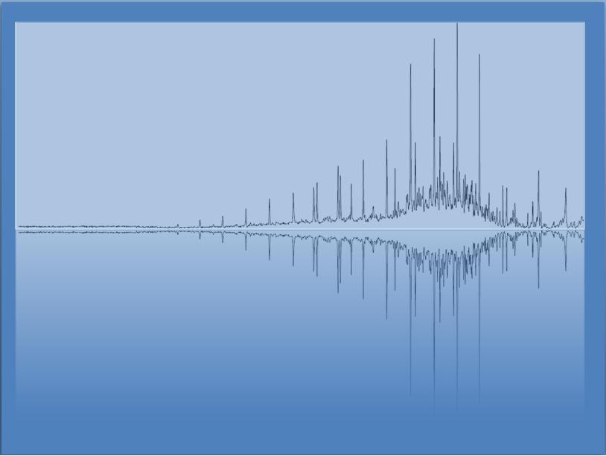
Reaction Stoichiometry
Chem 3A- Yates

Slide 2
Outline
What is Stoichiometry?
Solid Phase Stoichiometry
Basic mass-to-mass conversions
Limiting/excess reactants
Theoretical yield
% yield
Solution Phase Stoichiometry
Gaseous Phase Stoichiometry
Reaction Heat Stoichiometry

Slide 3
Reaction Stoichiometry
The coefficients specify the relative amounts of each of the substances in the reaction.
2 C₈H₁₈(l) + 25 O₂(g) → 16 CO₂(g) + 18 H₂O(g)
2 molecules of C₈H₁₈ react with 25 molecules of O₂
to form 16 molecules of CO₂ and 18 molecules of H₂O
or
2 mol C₈H₁₈ : 25 mol O₂ : 16 mol CO₂ : 18 mol H₂O

Slide 4
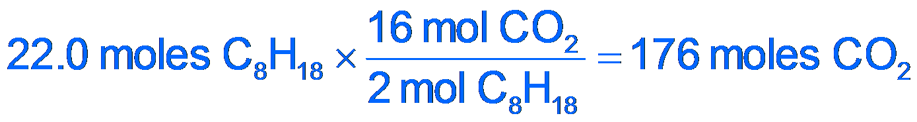
Predicting Amounts from Stoichiometry
How much CO₂ can be made from 22.0 moles of C₈H₁₈ in the combustion of C₈H₁₈?
2 C₈H₁₈(l) + 25 O₂(g) → 16 CO₂(g) + 18 H₂O(g)
2 moles C₈H₁₈ : 16 moles CO₂

Slide 5
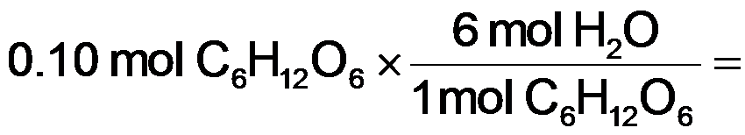
Example
According to the following equation, how many moles of water could be made in the combustion of 0.10 moles of glucose?
C₆H₁₂O₆ + 6 O₂ → 6 CO₂ + 6 H₂O
0.60 mol H₂O

Slide 6

Stoichiometry Tattoo
Randa Roland, Lecturer at U.C. Santa Cruz, taken from C&E News, Volume 93 Issue 3 | p. 30

Slide 7
Outline
What is Stoichiometry?
Solid Phase Stoichiometry
Basic mass-to-mass conversions
Limiting/excess reactants
Theoretical yield
% yield
Solution Phase Stoichiometry
Gaseous Phase Stoichiometry
Reaction Heat Stoichiometry

Slide 8
Example: Estimate the mass of CO₂ produced in 2007 by the combustion of 3.5 x 10¹⁵ g gasoline
Assuming that gasoline is octane, C₈H₁₈, the equation for the reaction is
2 C₈H₁₈(l) + 25 O₂(g) → 16 CO₂(g) + 18 H₂O(g)
The equation for the reaction gives the mole relationship between amount of C₈H₁₈ and CO₂, but we need to know the mass relationship, so the conceptual plan will be
g C₈H₁₈
mol C₈H₁₈
mol CO₂
g CO₂

Slide 9
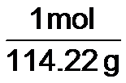
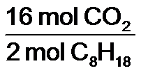

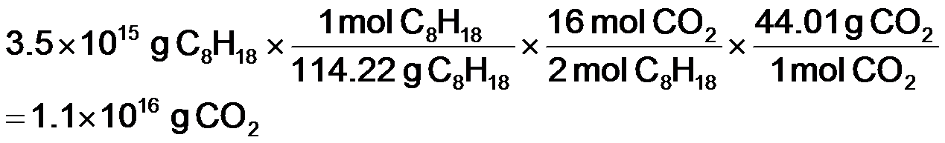
Example: Estimate the mass of CO₂ produced in 2007 by the combustion of 3.5 x 10¹⁵ g gasoline
Given:
Find:
3.4 x 10¹⁵ g C₈H₁₈
g CO₂
Conceptual Plan:
Relationships:
1 mol C₈H₁₈ = 114.22g, 1 mol CO₂ = 44.01g, 2 mol C₈H₁₈:16 mol CO₂
g C₈H₁₈
mol C₈H₁₈
mol CO₂
g CO₂
Solution:
Check:
because 8x moles of CO₂ as C₈H₁₈, but the molar mass of C₈H₁₈ is 3x CO₂, the number makes sense

Slide 10
Practice — How many grams of O₂ can be made from the decomposition of 100.0 g of PbO₂? 2 PbO₂(s) → 2 PbO(s) + O₂(g) (PbO₂ = 239.2 g/mol, O₂ = 32.00 g/mol)

Slide 11
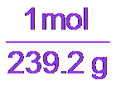
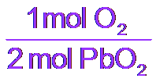

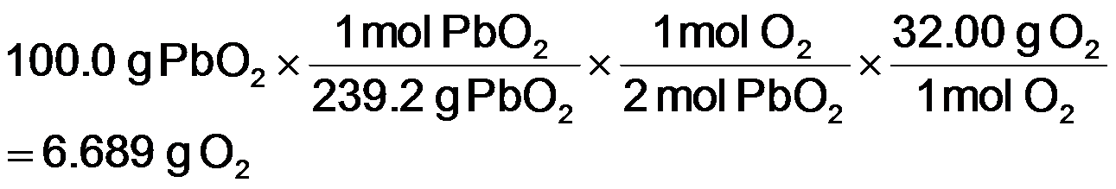
Practice — How many grams of O₂ can be made from the decomposition of 100.0 g of PbO₂? 2 PbO₂(s) → 2 PbO(s) + O₂(g)
Given:
Find:
100.0 g PbO₂, 2 PbO₂ → 2 PbO + O₂
g O₂
Conceptual Plan:
Relationships:
1 mol O₂ = 32.00g, 1 mol PbO₂ = 239.2g, 1 mol O₂ : 2 mol PbO₂
g PbO₂
mol PbO₂
mol O₂
g O₂
Solution:
Check:
because ½ moles of O₂ as PbO₂, and the molar mass of PbO₂ is 7x O₂, the number makes sense
Notes:
11

Slide 12
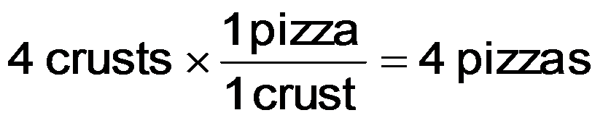

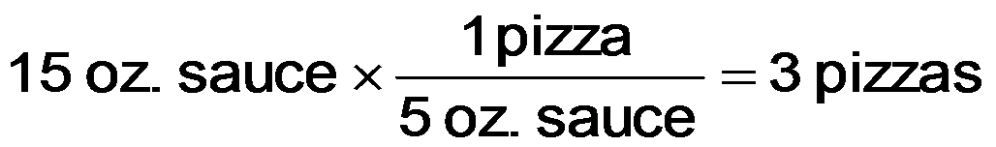

Making Pizzas (An analogy for limiting reactants, theoretical yield, and % yield)
-Given the following “equation” for making a pizza.
1 crust + 5 oz. tomato sauce + 2 cu cheese → 1 pizza
-How many could we make if we had 4 crusts,
15 oz. tomato sauce, and 10 cu cheese?

Slide 13
The Limiting Reactant
The reactant that limits the amount of product is called the limiting reactant
sometimes called the limiting reagent
the limiting reactant gets completely consumed
Reactants not completely consumed are called excess reactants
The amount of product that can be made from the limiting reactant is called the theoretical yield

Slide 14
Practice — How many moles of Si₃N₄ can be made from 1.20 moles of Si and 1.00 moles of N₂ in the reaction 3 Si + 2 N₂ → Si₃N₄?

Slide 15


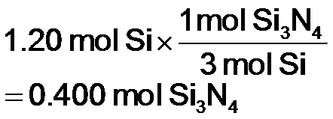
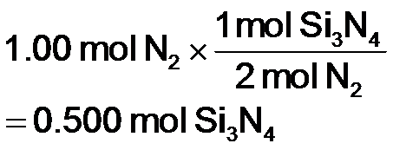
Practice — How many moles of Si₃N₄ can be made from 1.20 moles of Si and 1.00 moles of N₂ in the reaction 3 Si + 2 N₂ → Si₃N₄?
Given:
Find:
1.20 mol Si, 1.00 mol N₂
mol Si₃N₄
Conceptual Plan:
Relationships:
2 mol N₂ : 1 Si₃N₄; 3 mol Si : 1 Si₃N₄
mol Si
mol Si₃N₄
Pick least
amount
Limiting
reactant and
theoretical
yield
mol N₂
mol Si₃N₄
Solution:
Limiting
reactant
Theoretical
yield
Notes:
15

Slide 16
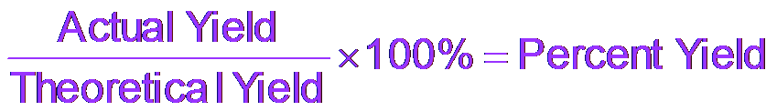
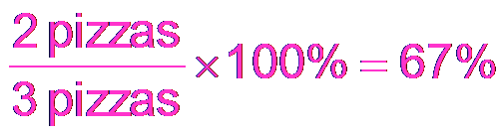
More Making Pizzas
Let’s now assume that as we are making pizzas, we burn a pizza, so that we only make two pizzas.
The actual amount of product made in a chemical reaction is called the actual yield.
We can calculate the percentage of the maximum number of pizzas we actually make.
In chemical reactions, we call this the percent yield.

Slide 17
Example:
When 28.6 kg of C are allowed to react with 88.2 kg of TiO₂ in the reaction below, 42.8 kg of Ti are obtained. Find the limiting reactant, theoretical yield, and percent yield.

Slide 18
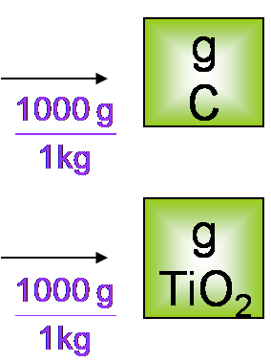
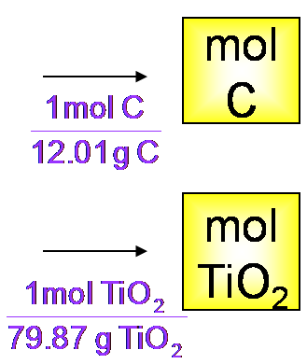
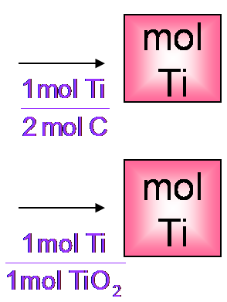
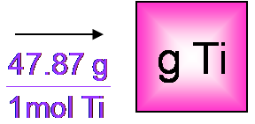
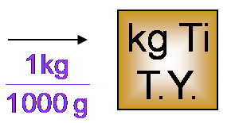
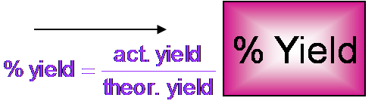
Example: Find the limiting reactant, theoretical yield, and percent yield TiO₂(s) + 2 C(s) → Ti(s) + 2 CO(g)
Information
Given: 28.6 kg C, 88.2 kg TiO₂, 42.8 kg Ti
Find: lim. rct., theor. yld., % yld.
Write a conceptual plan
}
kg
C
smallest
amount is
from
limiting
reactant
kg
TiO₂
smallest
mol Ti
Tro: Chemistry: A Molecular Approach, 2/e

Slide 19
Example: Find the limiting reactant, theoretical yield, and percent yield TiO₂(s) + 2 C(s) → Ti(s) + 2 CO(g)
Information
Given: 28.6 kg C, 88.2 kg TiO₂, 42.8 kg Ti
Find: lim. rct., theor. yld., % yld.
CP: kg rct → g rct → mol rct → mol Ti
pick smallest mol Ti → TY kg Ti → %Y Ti
Rel: 1 mol C=12.01g; 1 mol Ti =47.87g;
1 mol TiO₂ = 79.87g; 1000g = 1 kg;
1 mol TiO₂ : 1 mol Ti; 2 mol C : 1 mol Ti
Check the solutions
limiting reactant = TiO₂
theoretical yield = 52.9 kg
percent yield = 81.0%
Because Ti has lower molar mass than TiO₂, the T.Y. makes
sense and the percent yield makes sense as it is less than 100%

Slide 20
Practice — How many grams of N₂(g) can be made from 9.05 g of NH₃ reacting with 45.2 g of CuO? 2 NH₃(g) + 3 CuO(s) → N₂(g) + 3 Cu(s) + 3 H₂O(l) If 4.61 g of N₂ are made, what is the percent yield?
Tro: Chemistry: A Molecular Approach, 2/e

Slide 21
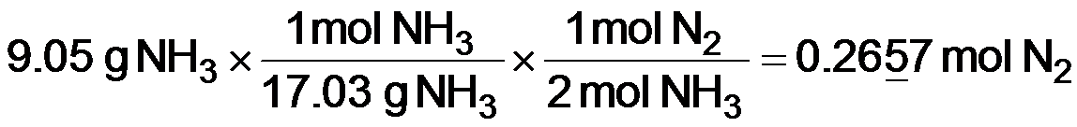
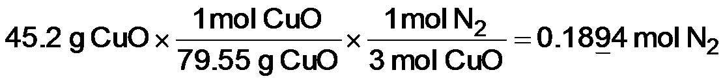
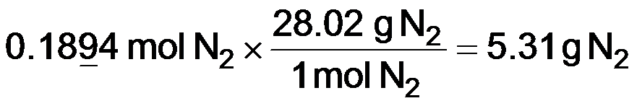
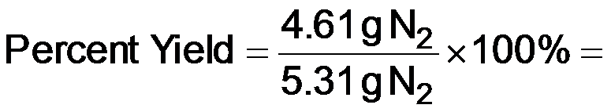
Practice — How many grams of N₂(g) can be made from 9.05 g of NH₃ reacting with 45.2 g of CuO? 2 NH₃(g) + 3 CuO(s) → N₂(g) + 3 Cu(s) + 3 H₂O(l) If 4.61 g of N₂ are made, what is the percent yield?
Solution:
Theoretical
yield
86.9% yield
5.307 g N₂
Check:
because the percent yield is less than 100, the answer makes sense

Slide 22
Outline
What is Stoichiometry?
Solid Phase Stoichiometry
Basic mass-to-mass conversions
Limiting/excess reactants
Theoretical yield
% yield
Solution Phase Stoichiometry
Gaseous Phase Stoichiometry
Reaction Heat Stoichiometry

Slide 23
Solution Stoichiometry
Randa Roland, Lecturer at U.C. Santa Cruz, taken from C&E News, Volume 93 Issue 3 | p. 30

Slide 24
Solution Stoichiometry
Mole Ratio
Molarity
Molarity
V (Liters) of A
mole A
mole B
V (Liters) of B

Slide 25
How many Liters of 0.115 M KI Is Needed to React with 0.104 L of a 0.225 M Pb(NO₃)₂? 2 KI(aq) + Pb(NO₃)₂(aq)→ 2 KNO₃(aq) + PbI₂(s)

Slide 26
How many Liters of 0.115 M KI Is Needed to React with 0.104 L of a 0.225 M Pb(NO₃)₂? 2 KI(aq) + Pb(NO₃)₂(aq)→ 2 KNO₃(aq) + PbI₂(s)
Mole Ratio
Molarity
Molarity
V (Liters) of A
mole A
mole B
V (Liters) of B

Slide 27
How many Liters of 0.115 M KI Is Needed to React with 0.104 L of a 0.225 M Pb(NO₃)₂? 2 KI(aq) + Pb(NO₃)₂(aq)→ 2 KNO₃(aq) + PbI₂(s)
Mole Ratio
Molarity
Molarity
V (Liters) of A
mole A
mole B
V (Liters) of B
= 0.40696 L
= 0.407 L KI sol’n

Slide 28
Practice—How Many Liters of 0.0623 M Ba(OH)₂(aq) Are Needed to React with 0.438 L of 0.107 M HCl? Ba(OH)₂(aq) + 2 HCl(aq) → BaCl₂(aq) + 2 H₂O(l)

Slide 29
How Many Liters of 0.0623 M Ba(OH)₂(aq) Are Needed to React with 0.438 L of 0.107 M HCl? Ba(OH)₂(aq) + 2 HCl(aq) → BaCl₂(aq) + 2 H₂O(l), Continued
Given:
Find:
0.0.438 L HCl
L Ba(OH)₂
Solution Map:
Relationships:
0.0623 mol Ba(OH)₂ = 1 L; 2 mol HCl= 1 mol Ba(OH)_{2;} 0.107 mol HCl = 1 L
L
HCl
mol
HCl
mol
Ba(OH)₂
L
Ba(OH)₂
Solve:
Check:
The unit is correct.

Slide 30
Outline
What is Stoichiometry?
Solid Phase Stoichiometry
Basic mass-to-mass conversions
Limiting/excess reactants
Theoretical yield
% yield
Solution Phase Stoichiometry
Gaseous Phase Stoichiometry
Reaction Heat Stoichiometry

Slide 31
Gas-Phase Stoichiometry
Randa Roland, Lecturer at U.C. Santa Cruz, taken from C&E News, Volume 93 Issue 3 | p. 30

Slide 32
Gas-Phase Stoichiometry
P, V, T of Gas A
mole A
mole B
P, V, T of Gas B

Slide 33
Example 11.11:
How many liters of oxygen gas form when 294 g of KClO₃ completely reacts in the following reaction? Assume the oxygen gas is collected at P = 755 mmHg and T = 305 K.

Slide 34
Example 11.11—How Many Liters of O₂ Are Made from 294 g of KClO₃ at 755 mmHg and 305 K? 2 KClO₃(s) → 2 KCl(s) + 3 O₂(g)
Given:
Find:
n_{O2} = 3.60 mol, P = 0.99342 atm, T = 305 K
V_{O2}, L
m_{KClO3} = 294 g, P=755 mmHg, T=305 K
V_{O2}, L
Solution Map:
Relationships:
g KClO₃
mol KClO₃
mol O₂
P, n, T, R
V
1 atm = 760 mmHg, KClO₃ = 122.5 g/mol
2 mol KClO₃ : 3 mol O₂
Solution:

Slide 35
Example 11.11:
How many liters of oxygen gas form when 294 g of KClO₃ completely reacts in the following reaction? Assume the oxygen gas is collected at STP.

Slide 36
Outline
What is Stoichiometry?
Solid Phase Stoichiometry
Basic mass-to-mass conversions
Limiting/excess reactants
Theoretical yield
% yield
Solution Phase Stoichiometry
Gaseous Phase Stoichiometry
Reaction Heat Stoichiometry

Slide 37
Heat Energy and Stoichiometry
The amount of energy change in a reaction depends on the amount of reactants.
You get twice as much heat out when you burn twice as much CH₄.
The amount of energy absorbed or released can be used as a stoichiometric quantity.
C₃H₈(l) + 5 O₂(g) → 3 CO₂(g) + 4 H₂O(g) ΔH_{rxn} = −2044 kJ
1 mol C₃H₈ : 5 mol O₂ : 3 mol CO₂ : 4 mol H₂O : −2044 kJ

Slide 38
Example—How Much Heat Is Associated with the Complete Combustion of 11.8 x 10³ g of C₃H₈(g)?
Given:
Find:
11.8 x 10³ g C₃H₈,
heat, kJ
Solution Map:
Relationships:
1 mol C₃H₈ = -2044 kJ, Molar mass = 44.11 g/mol
g C₃H₈
mol C₃H₈
kJ
Solution:
Check:
The sign is correct and the value is reasonable.

Slide 39
Practice—How Much Heat Is Evolved When a 0.483 g Diamond Is Burned? (ΔH_{combustion} = −395.4 kJ/mol C)

Slide 40
Practice—How Much Heat Is Evolved When a 0.483 g Diamond Is Burned? (ΔH_{combustion} = −395.4 kJ/mol C), Continued
Given:
Find:
0.483 g C
heat, kJ
Solution Map:
Relationships:
1 mol C = −395.4 kJ, Molar mass = 12.01 g/mol
g C
mol C
kJ
Solution:
Check:
The sign is correct and the value is reasonable since there is less than 0.1 mol C.

Slide 41
